Slide 1
Best use of information
Business Intelligence & Analytics

Slide 2
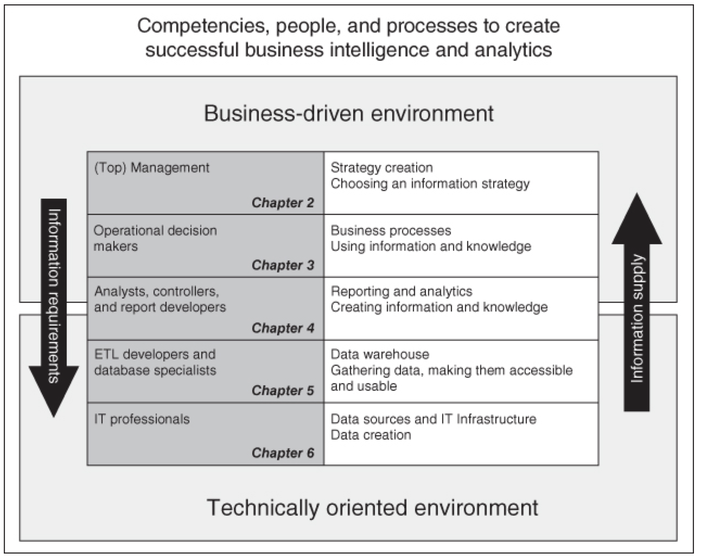
Checking in
Recap
Moved “backward” toward the most technical/low level portion of our data
To the source system
How do we start moving back up the tech stack to provide information (and knowledge)

Slide 3
Example: Churn
What data do we have available?
Any of the dozens of data sets from our data-generating source systems
Should we use that data?
In general, we don’t know
Make a list of data sets that should be used for the specific task at hand (build a Churn model/understand customer health)

Slide 4
what might be relevant?
Customer purchasing events
Product usage by feature
Details of their contract
How do they intend to use the product
Who sold the deal
Customer properties (industry, # of employees)
Key personas w/in the account

Slide 5
What isn’t relevant?
Our current org structure
Amount of PTO taken by employee
What features of our product will be released next year?
Keynote speakers at our annual user conference
New marketing campaigns to be released next month
Departmental budgets

Slide 6
After the exercise of determining what might be relevant to the problem at hand, what’s next?
Need to outline what data you have that is related.
Many times if the exact data is not available, a suitable substitute can be derived from existing data
Need to know how to get from point A to point B
This is where a skilled analyst comes in handy

Slide 7
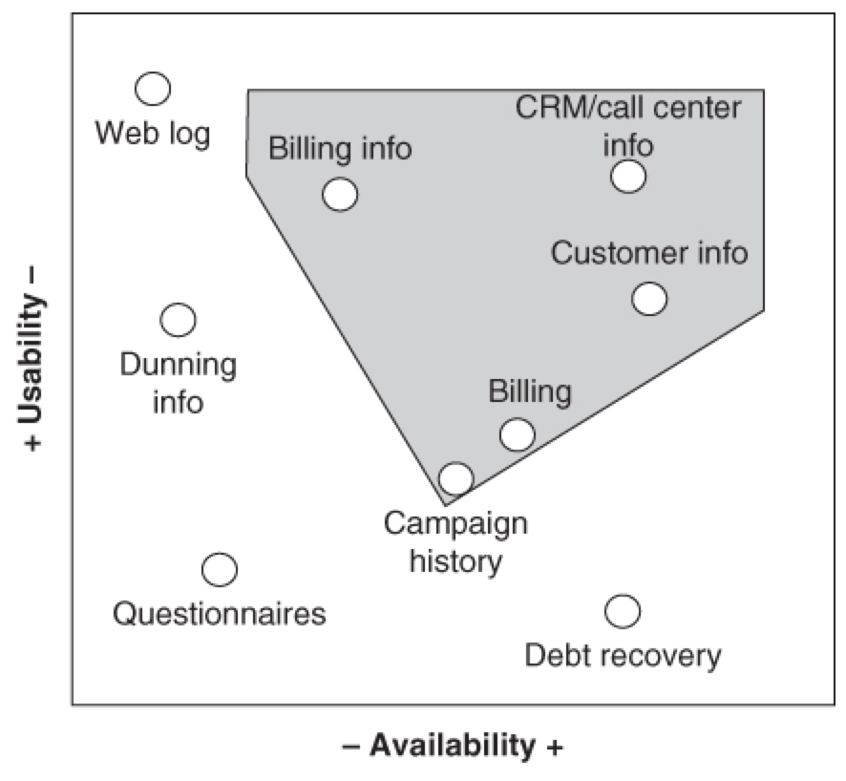
Availability
Data may not be stored in a system where it can be extracted
The effort to extract the data may be too great
There may be no key to join on (so the data can’t be combined with data from other systems)
The data may not be collected at the right time intervals
You may not be collecting the data at all
Usability
Data may not be relevant to the task at hand

Slide 8
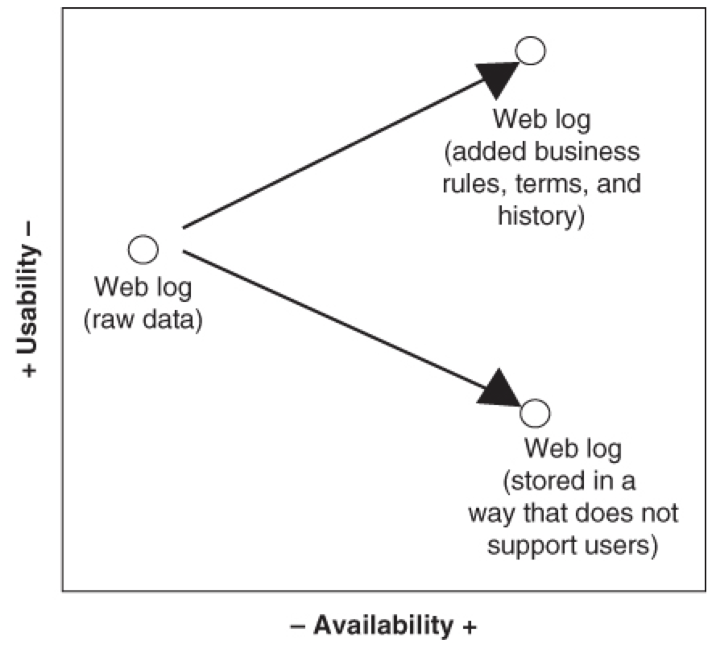
Availability
Data can be made more available by moving it into the data warehouse
Usability
Usability can be increased if the data is enriched with other business rules and history
Usability can be decreased if the data is aggregated or if information is removed as it is moved into the data warehouse

Slide 9
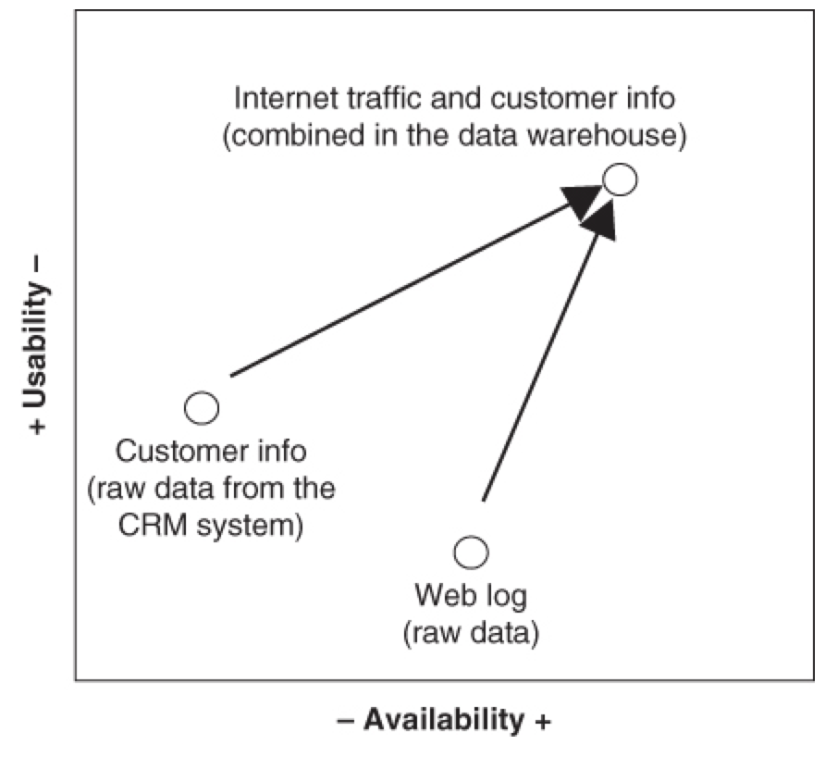
Availability
Data can be made more available by moving it into the data warehouse
Usability
Usability can generally be increased if it is joined with data from other systems

Slide 10

Map the question at hand to relevant real-world events
Determine if you have data to support
May need to derive
Data can be made more available or useable via the data warehouse

Slide 11


